Slide 1
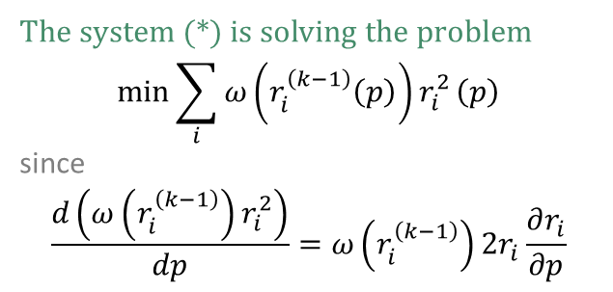
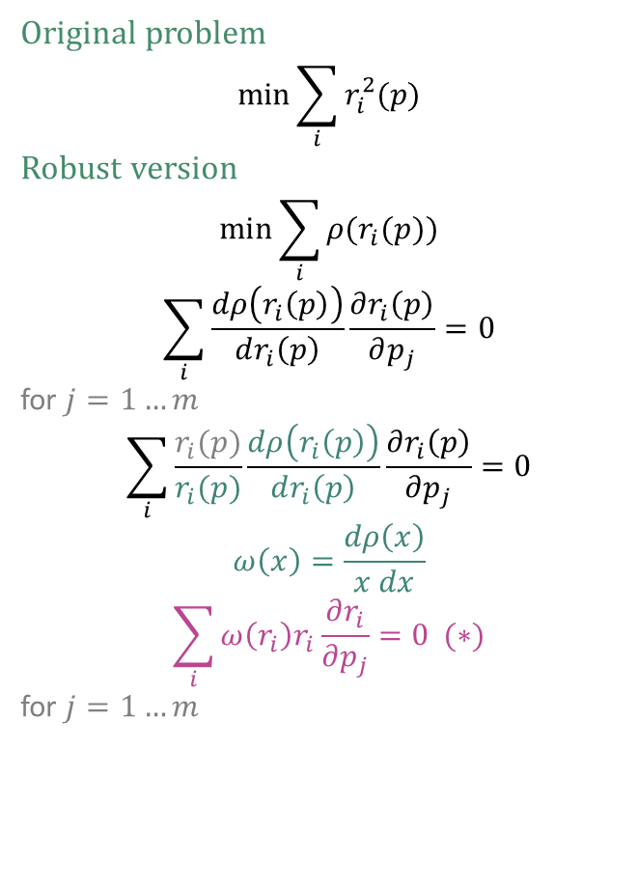
Iteratively reweighted least squares
Original problem
$$\min{\sum_{i}{r_{i}^{2}(p)}}$$
Robust version
$$\min{\sum_{i}{ρ(r_{i}(p))}}$$
$$\sum_{i}{\frac{dρ\left(r_{i}\left(p\right)\right)}{dr_{i}\left(p\right)}\frac{∂r_{i}\left(p\right)}{∂p_{j}}}=0$$
for $j=1…m$
$$\sum_{i}{\frac{r_{i}(p)}{r_{i}(p)}\frac{dρ\left(r_{i}\left(p\right)\right)}{dr_{i}\left(p\right)}\frac{∂r_{i}\left(p\right)}{∂p_{j}}}=0$$
$$ω\left(x\right)=\frac{dρ\left(x\right)}{x dx}$$
$$\sum_{i}{ω\left(r_{i}\right)r_{i}\frac{∂r_{i}}{∂p_{j}}}=0 (∗)$$
for $j=1…m$
The system (*) is solving the problem
$$\min{\sum_{i}{ω\left(r_{i}^{\left(k−1\right)}\left(p\right)\right)r_{i}^{2}}}\left(p\right)$$
since
$$\frac{d\left(ω\left(r_{i}^{\left(k−1\right)}\right)r_{i}^{2}\right)}{dp}=ω\left(r_{i}^{\left(k−1\right)}\right)2r_{i}\frac{∂r_{i}}{∂p}$$

Slide 2
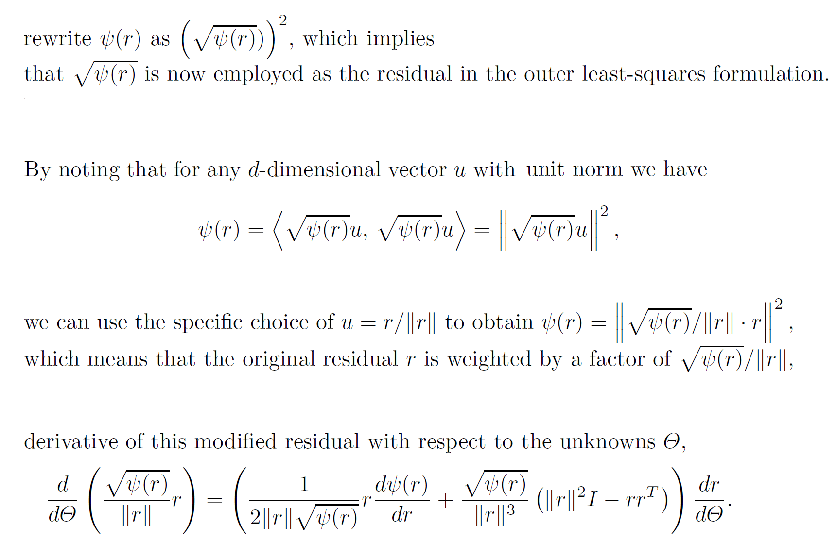
Square-rooting the kernel

Slide 3
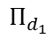
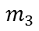
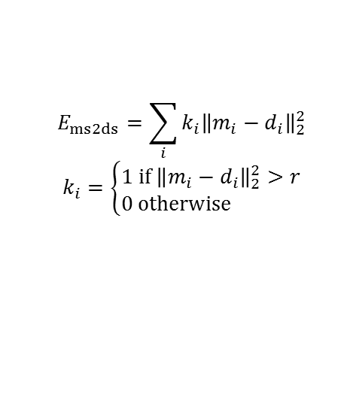
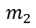
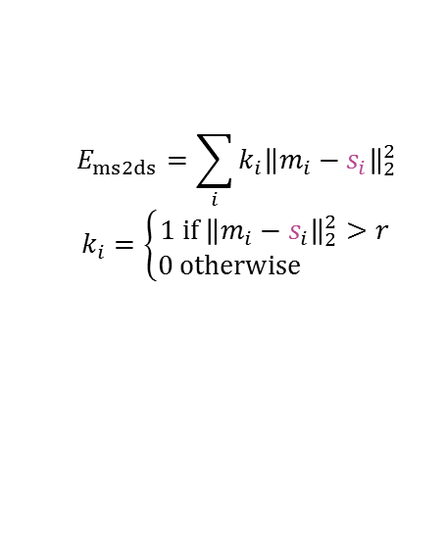
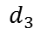
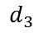
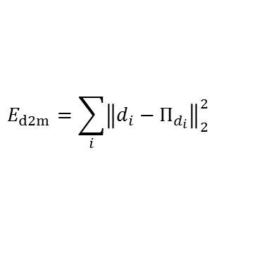
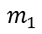
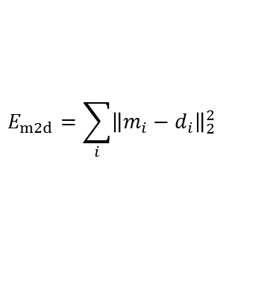
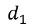
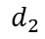
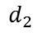
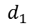
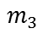
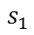
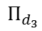
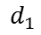
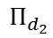
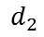
Data energies
d2m – data to model energy
m2d – model to data energy
ms2ds – model-silhouette to data-silhouette energy
fixed ms2ds – model-silhouette to data-silhouette energy
$$m_{1}$$
$$m_{1}$$
$$m_{1}$$
$$s_{1}$$
$$r$$
$$r$$
$$Π_{d_{1}}$$
$$d_{1}$$
$$d_{1}$$
$$d_{1}$$
$$m_{2}$$
$$m_{2}$$
$$d_{1}$$
$$m_{2}$$
$$Π_{d_{2}}$$
$$d_{2}$$
$$d_{2}$$
$$d_{2}$$
$$d_{2}$$
$$Π_{d_{3}}$$
$$d_{3}$$
$$m_{3}$$
$$d_{3}$$
$$d_{3}$$
$$d_{3}$$
$$m_{3}$$
$$m_{3}$$
$$E_{d2m}=\sum_{i}{{\left\|d_{i}−Π_{d_{i}}\right\|}_{2}^{2}}$$
$$E_{m2d}=\sum_{i}{{\left\|m_{i}−d_{i}\right\|}_{2}^{2}}$$
$$E_{ms2ds}=\sum_{i}{{k_{i}\left\|m_{i}−d_{i}\right\|}_{2}^{2}}$$
$$k_{i}=\left\{\begin{matrix}1 if{ \left\|m_{i}−d_{i}\right\|}_{2}^{2}>r \\ 0 otherwise \end{matrix}\right.$$
$$E_{ms2ds}=\sum_{i}{{k_{i}\left\|m_{i}−s_{i}\right\|}_{2}^{2}}$$
$$k_{i}=\left\{\begin{matrix}1 if{ \left\|m_{i}−s_{i}\right\|}_{2}^{2}>r \\ 0 otherwise \end{matrix}\right.$$

Slide 4
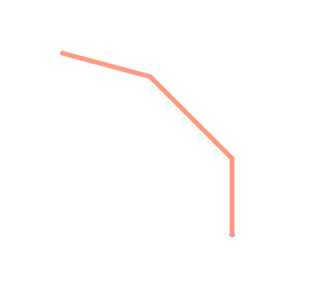
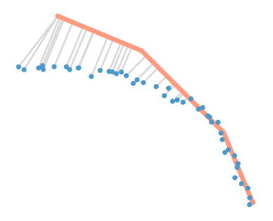
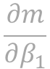
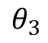
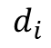
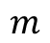
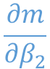
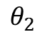
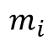
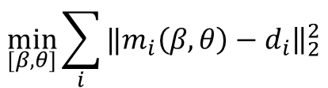
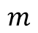
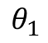
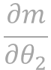
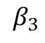
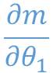
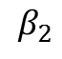
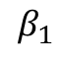
$$β_{3}$$
$$θ_{3}$$
$$\frac{∂m}{∂β_{1}}$$
$$\frac{∂m}{∂θ_{1}}$$
$$\frac{∂m}{∂β_{2}}$$
$$m$$
$$β_{2}$$
$$\frac{∂m}{∂θ_{2}}$$
$$m$$
$$θ_{2}$$
$$β_{1}$$
$$θ_{1}$$
$$m_{i}$$
$$d_{i}$$
$$\min_{[β, θ]}{\sum_{i}{‖{\left.​m_{i}\left(β, θ\right)−d_{i}\right\|}_{2}^{2}}}$$

Slide 5
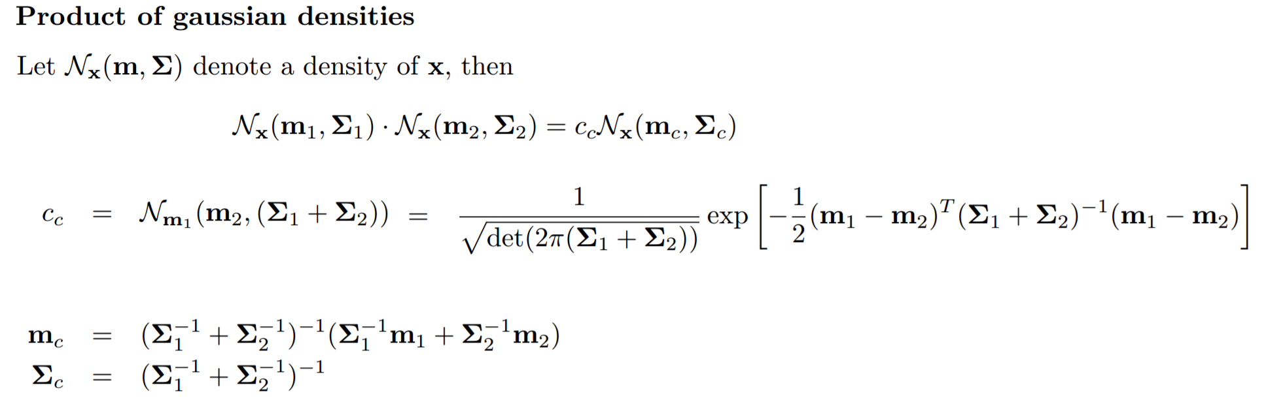
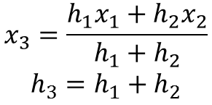
$$x_{3}=\frac{h_{1}x_{1}+h_{2}x_{2}}{h_{1}+h_{2}}$$
$$h_{3}=h_{1}+h_{2}$$

Slide 6

Adding new dofs
Edit shape chains
Change SHAPE_MAX_LENGTH
Edit block-id to shape-dof-id map
Set up phalange, type and limit of new dofs
Edit templates
Set up damping
Edit get-beta
Edit update-beta
Serialize-beta-infos
Edit Jacobian verifier
Edit update-beta-double
Edit Jacobians on Cuda
Edit update-phalanges

Slide 7
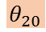
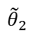
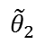
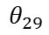
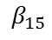
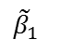
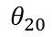
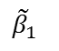


$$θ_{20}$$
$$θ_{29}$$
$$β_{15}$$
$${\tilde{θ}}_{2}$$
$${\tilde{β}}_{1}$$
$$β_{15}$$
$${\tilde{θ}}_{2}$$
$${\tilde{β}}_{1}$$
$$θ_{20}$$
$${\tilde{θ}}_{2}$$

Slide 8








$$θ_{20}$$
$$β_{15}$$
$${\tilde{θ}}_{2}$$
$${\tilde{β}}_{1}$$
$$θ_{1}$$
$${\tilde{θ}}_{1}$$
$$β$$
$$\tilde{β}$$

Slide 9








Offline Batch
$$θ_{1}$$
$$θ_{1}$$
$${\tilde{θ}}_{1}$$
$${\tilde{θ}}_{1}$$
$$θ_{2}$$
$$β$$
$$\tilde{β}$$
$${\tilde{θ}}_{2}$$
$$β$$
$$θ_{2}$$
$${\tilde{θ}}_{2}$$
$$\tilde{β}$$
$$θ_{1}$$
$${\tilde{θ}}_{1}$$
$$β$$
$$\tilde{β}$$

Slide 10
Online Batch

Slide 11
Centers
Blocks
0: pinky-top
1: pinky-middle
2: pinky-bottom
3: pinky-base
4: ring-top
5: ring-middle
6: ring-bottom
7: ring-base
8: middle-top
9: middle-middle
10: middle-bottom
11: middle-base
12: index-top
13: index-middle
14: index-bottom
15: index-base
16: thumb-top
17: thumb-middle
18: thumb-bottom
19: thumb-base
20: palm-pinky
21: palm-ring
22: palm-middle
23: palm-index
24: palm-thumb
25: palm-back
26: palm-right
27: palm-left
28: pinky-membrane
29: ring-membrane
30: middle-membrane
31: index-membrane
32: thumb-additional
33: thumb-membrane-left
34: wrist-top-left
35: wrist-top-right
36: wrist-bottom-left
37: wrist-bottom-right
38: thumb-membrane-middle
12
8
4
0: (1, 0)
1: (2, 1)
2: (3, 2)
3: (5, 4)
4: (6, 5)
5: (7, 6)
6: (9, 8)
7: (10, 9)
8: (11, 10)
9: (13, 12)
10: (14, 13)
11: (15, 14)
12: (17, 16)
13: (18, 17)
14: (19, 18 )
15: (26, 21, 20)
16: (25, 26, 21)
17: (25, 22, 21)
18: (25, 27, 22)
19: (27, 22, 23)
20: (20, 29, 28)
21: (21, 20, 29)
22: (21, 30, 29)
23: (22, 21, 30)
24: (22, 23, 30)
25: (23, 30, 31)
26: (19, 24, 38)
27: (16, 32)
28: (36, 34, 35)
29: (37, 36, 35)
30: (19, 38, 33)
6
3
0
9
13
9
5
0
1
10
7
4
10
1
14
6
2
32
11
8
5
2
16
31
30
29
28
27
25
22
20
15
11
7
3
12
24
23
21
17
23
22
21
20
38
24
33
13
19
17
15
30
26
18
18
16
14
19
27
25
26
34
35
28
36
37
29

Slide 12



Pose Units
Thetas
Kinematic Chains (Chain of Thetas)
15
12
phalange $→$ thetas its shape depends on
0: “hand” $→$ 0, 1, 2, 3, 4, 5
1: “thumb1” $→$ 9, 10, 29, 0, 1, 2, 3, 4, 5
2: “thumb2” $→$ 11, 9, 10, 29, 0, 1, 2, 3, 4, 5
3: “thumb3” $→$ 12, 11, 9, 10, 29, 0, 1, 2, 3, 4, 5
4: “pinky1” $→$25, 26, 33, 0, 1, 2, 3, 4, 5
5: “pinky2” $→$ 27, 25, 26, 33, 0, 1, 2, 3, 4, 5
6: “pinky3” $→$ 28, 27, 25, 26, 33, 0, 1, 2, 3, 4, 5
7: “ring1” $→$21, 22, 32, 0, 1, 2, 3, 4, 5
8: “ring2” $→$ 23, 21, 22, 32, 0, 1, 2, 3, 4, 5
9: “ring3” $→$ 23, 24, 21, 22, 32, 0, 1, 2, 3, 4, 5
10: “middle1” $→$17, 18, 31, 0, 1, 2, 3, 4, 5
11: “middle2” $→$ 19, 17, 18, 31, 0, 1, 2, 3, 4, 5
12: “middle3” $→$ 20, 19, 17, 18, 31, 0, 1, 2, 3, 4, 5
13: “index1” $→$ 13, 14, 30, 0, 1, 2, 3, 4, 5
14: “index2“ $→$ 15, 13, 14, 30, 0, 1, 2, 3, 4, 5
15: “index3” $→$ 16, 15, 13, 14, 30, 0, 1, 2, 3, 4, 5
16: “wrist” $→$ 7, 8, 0, 1, 2, 3, 4, 5
17: “membrane-index-middle-top” $→$ 13, 14, 17, 18, 0, 1, 2, 3, 4, 5
18: “membrane-index-middle-bottom” $→$ 17, 18, 0, 1, 2, 3, 4, 5
19: “membrane-middle-ring-top” $→$ 17, 18, 21, 22, 0, 1, 2, 3, 4, 5
20: “membrane-middle-ring-bottom” $→$ 17, 18, 0, 1, 2, 3, 4, 5
21: “membrane-ring-pinky-top” $→$ 21, 22, 25, 26, 0, 1, 2, 3, 4, 5
22: “membrane-ring-pinky-bottom” $→$ 21, 22, 0, 1, 2, 3, 4, 5
9
6
16
20
24
14
11
8
28
5
15
19
23
27
13
10
7
4
17
19
21
3
18
20
22
13
14
30
17
18
31
21
22
32
25
26
33
12
2
24
23
$$0$$
11
1
0
3
9
10
29
1
4
twist (Y)
2
5
[0, 1, 0]
7
8
[1, 0, 0]
flexion (X)
[0, 0, 1]
$$16$$
abduction (Z)

Slide 13


















Shape Units
Betas
Shape Chains (Chain of Betas)
11
7
15
shape-unit $→$ betas its shape depends on
0: “thumb1” $→$ 15, 16, 17, 0, 0, 1
1: “thumb2” $→$ 15, 16, 17, 0, 1, 1, 2
2: “thumb3” $→$ 15, 16, 17, 0, 1, 2, 2, 3
3: “index1” $→$ 18, 19, 20, 3, 4, 5
4: “index2” $→$18, 19, 20, 3, 4, 5, 6
5: “index3” $→$ 18, 19, 20, 3, 4, 5, 6, 7
6: “middle1” $→$ 21, 22, 23, 6, 8, 9
7: “middle2” $→$ 21, 22, 23, 6, 7, 9, 10
8: “middle3” $→$ 21, 22, 23, 6, 7, 8, 10, 11
9: “ring1” $→$ 24, 25, 26, 9, 12, 13
10: “ring2” $→$ 24, 25, 26, 9, 10, 13, 14
11: “ring3” $→$ 24, 25, 26, 9, 10, 11, 14, 15
12: “pinky1” $→$ 27, 28, 29, 12, 16, 17
13: “pinky2” $→$ 27, 28, 29, 12, 13, 17, 18
14: “pinky3” $→$ 27, 28, 29, 12, 13, 14, 18, 19
15: “palm-top-left” $→$ 30, 31, 32, 33, 34, 35, 20, 21, 24
16: “palm-bottom-left” $→$ 30, 31, 32, 33, 34, 35, 21, 24, 25
17: “palm-middle” $→$ 30, 31, 32, 33, 21, 22, 25
18: “palm-bottom-right” $→$ 30, 31, 32, 33, 36, 37, 22, 25, 26
19: “palm-top-right” $→$ 30, 31, 32, 33, 36, 37, 22, 23, 26
20: “membrane-index-middle-top” $→$ 3, 6, 18, 19, 20, 21, 22, 23, 30, 31, 20 21: “membrane-index-middle-bottom” $→$ 6, 21, 22, 23, 30, 31, 32, 33, 20, 21
22: “membrane-middle-ring-top” $→$ 6, 9, 21, 22, 23, 24, 25, 26 , 30, 31, 32, 33, 22
23: “membrane-middle-ring-bottom” $→$ 6, 21, 22, 23, 30, 31, 32, 33, 21, 22
24: “membrane-ring-pinky-top” $→$ 9, 12, 24, 25, 26, 27, 28, 29, 32, 33, 23
25: “membrane-ring-pinky-bottom” $→$ 9, 24, 25, 26, 30, 31, 32, 33, 22, 23
26: “membrane-thumb-middle” $→$ 0, 15, 16, 17, 38, 39, 42, 0
27: “wrist” $→$ 40, 41
28: “membrane-thumb-left” $→$ 0, 15, 16, 17, 38, 39, 42, 0
+40
5
8
5
8
11
11
19
14
6
10
14
14
7
7
18
4
10
4
10
13
13
5
9
13
17
3
6
9
12
43, 44
3
6
9
12
28
20
22
24
3
2
21
23
25
2
4
8
12
16
$$30 31$$
$$32 33$$
2
20
21
22
23
$$38 39$$
$$\begin{matrix}18 \\ 19 \\ 20\end{matrix}$$
$$\begin{matrix}21 \\ 22 \\ 23\end{matrix}$$
$$\begin{matrix}24 \\ 25 \\ 26\end{matrix}$$
$$\begin{matrix}27 \\ 28 \\ 29\end{matrix}$$
1
$$15$$
$$17$$
$$19$$
1
42
26
$$16$$
$$18$$
1
0
0
0
$$\begin{matrix}15 \\ 16 \\ 17\end{matrix}$$
24
25
26
$$34 35$$
$$36 37$$
27
$$41$$
$$40$$

Slide 14

17
33
38
24
30
26
18
14, glm::ivec3(18, 19, 40),
26, glm::ivec3(19, 24, 38),
30, glm::ivec3(19, 38, 39),
31, glm::ivec3(19, 39, 40),
32, glm::ivec3(19, 40, 33),
33, glm::ivec3(18, 41, 40),
14
19
17
24
40
39
38
33
41
31
30
26
32
18
14
19

Slide 15
Semantic Limits
palm-index-y + palm-index-r < index-base-y
palm-index-r <
index-base-z + index-base-r
index-base-x + index-base-r <
palm-index-x + palm-index-r
palm-back-y - palm-back-r < thumb-base-y – thumb-base-r
thumb-base-x + thumb-base-r < 0

Slide 16





Known Covariances
$${\tilde{β}}_{4}$$
middle-base-y + f * middle-base-l + palm-back-r >
(1 – f) * middle-base-l + middle-middle-l + middle-top-l
middle-base-y + (2 * f – 1) * middle-base-l >
middle-middle-l + middle-top-l
middle-base-y + palm-back-r >
middle-middle-l + middle-top-l
$${\tilde{β}}_{1}$$
$${\tilde{β}}_{5}$$
$${\tilde{β}}_{3}$$
thumb_base_radius < thumb_base_y + palm_back_radius
$${\tilde{β}}_{2}$$

Slide 17

Tompson
12
6
18
13
7
19
0
14
1
8
20
15
9
21
2
3
10
16
4
22
11
17
5
24
23
32
25
33
26
34
27
28
29
30
31
35

Slide 18




Slide 19
Figures

Slide 20








certain
uncertain
$$diag(\hat{H})$$
$$diag(H^{∗})$$

Slide 21


Slide 22


Slide 23




$$θ_{2}$$
$$\left[\begin{matrix}\frac{∂∂F}{∂β_{1}∂β_{1}} & \frac{∂∂F}{∂β_{2}∂β_{1}} \\ \frac{∂∂F}{∂β_{1}∂β_{2}} & \frac{∂∂F}{∂β_{2}∂β_{2}}\end{matrix}\right]$$
$$θ_{1}$$

Slide 24


Slide 25













Thetas
Betas
11
7
15
5
8
11
19
16
20
24
6
10
14
14
28
7
18
4
10
13
15
19
23
5
9
13
17
27
3
6
9
12
3
13
14
30
21
22
32
25
26
33
2
4
8
12
16
17
18
31
$$30 31$$
$$32 33$$
12
2
20
21
22
23
$$38 39$$
$$\begin{matrix}18 \\ 19 \\ 20\end{matrix}$$
$$\begin{matrix}21 \\ 22 \\ 23\end{matrix}$$
$$\begin{matrix}24 \\ 25 \\ 26\end{matrix}$$
$$\begin{matrix}27 \\ 28 \\ 29\end{matrix}$$
1
42
11
1
0
3
0
9
10
29
1
4
0
2
5
$$\begin{matrix}15 \\ 16 \\ 17\end{matrix}$$
24
25
26
$$34 35$$
$$36 37$$
7
8
$$41$$
$$40$$

Slide 26

Synthetic data
template
perturbation 3
error in calibrated
parameters
template
perturbation 2
template
perturbation 1
time
[Tan CVPR 2016]

Slide 27







Slide 28
Calibration for different users
Show models of all the people we tried on

Slide 29



Comparing with [Taylor et al. 2016] on NUY

Slide 30








Comparing with [Taylor et al. 2016] on Dexter

Slide 31


Comparing with [Taylor et al. 2016] on Teaser

Slide 32








